Slide 1

School of Coumputing Science and Engineering
Course Code: BCS01T1003 Course Name: Programming for Problem Solving – C
UNIT 4
Unions-
Difference between structure and union.
Faculty Name: Prof. (Dr.) Sansar Singh Chauhan Program Name: B. Tech. AI & DS

Slide 2
Outline
Unions:
Introduction
Difference between structure and union.
typedef
Enumerator constant
Program Name: B. Tech. AI & DS

Slide 3
Array of Structure
Recap…..
Struct student
{
int roll_no;
char f_name[10];
char l_name[10];
}s[5];
Program Name: B. Tech. AI & DS

Slide 4
Passing structure in function
We will consider four cases:
Passing the individual members to functions
Passing whole structure to functions
Passing structure pointer to functions
Passing array of structure to functions
Program Name: B. Tech. AI & DS

Slide 5
Union
A union is a derived data type—like a structure—with members that share the same storage space.
For different situations in a program, some variables may not be relevant, but other variables are—so a union shares the space instead of wasting storage on variables that are not being used.
The members of a union can be of any data type.
The number of bytes used to store a union must be at least enough to hold the largest member.
In most cases, unions contain two or more data types.
Only one member, and thus one data type, can be referenced at a time.
It is your responsibility to ensure that the data in a union is referenced with the proper data type.
Program Name: B. Tech. AI & DS

Slide 6
Union
A union is declared with keyword union in the same format as a structure.
The union definition
union number { int x; double y; };
Indicates that number is a union type with members int x and double y.
The union definition is normally placed in a header and included in all source files that use the union type.
Program Name: B. Tech. AI & DS

Slide 7
Union
The operations that can be performed on a union are the following:
assigning a union to another union of the same type,
taking the address (&) of a union variable,
and accessing union members using the structure member operator and the structure pointer operator.
Unions may not be compared using operators == and != for the same reasons that structures cannot be compared.
Program Name: B. Tech. AI & DS

Slide 8
Union
In a declaration, a union may be initialized with a value of the same type as the first union member.
For example, with the preceding union, the declaration
union number value = { 10 };
is a valid initialization of union variable value because the union is initialized with an int, but the following declaration would truncate the floating-point part of the initializer value and normally would produce a warning from the compiler:
Program Name: B. Tech. AI & DS

Slide 9
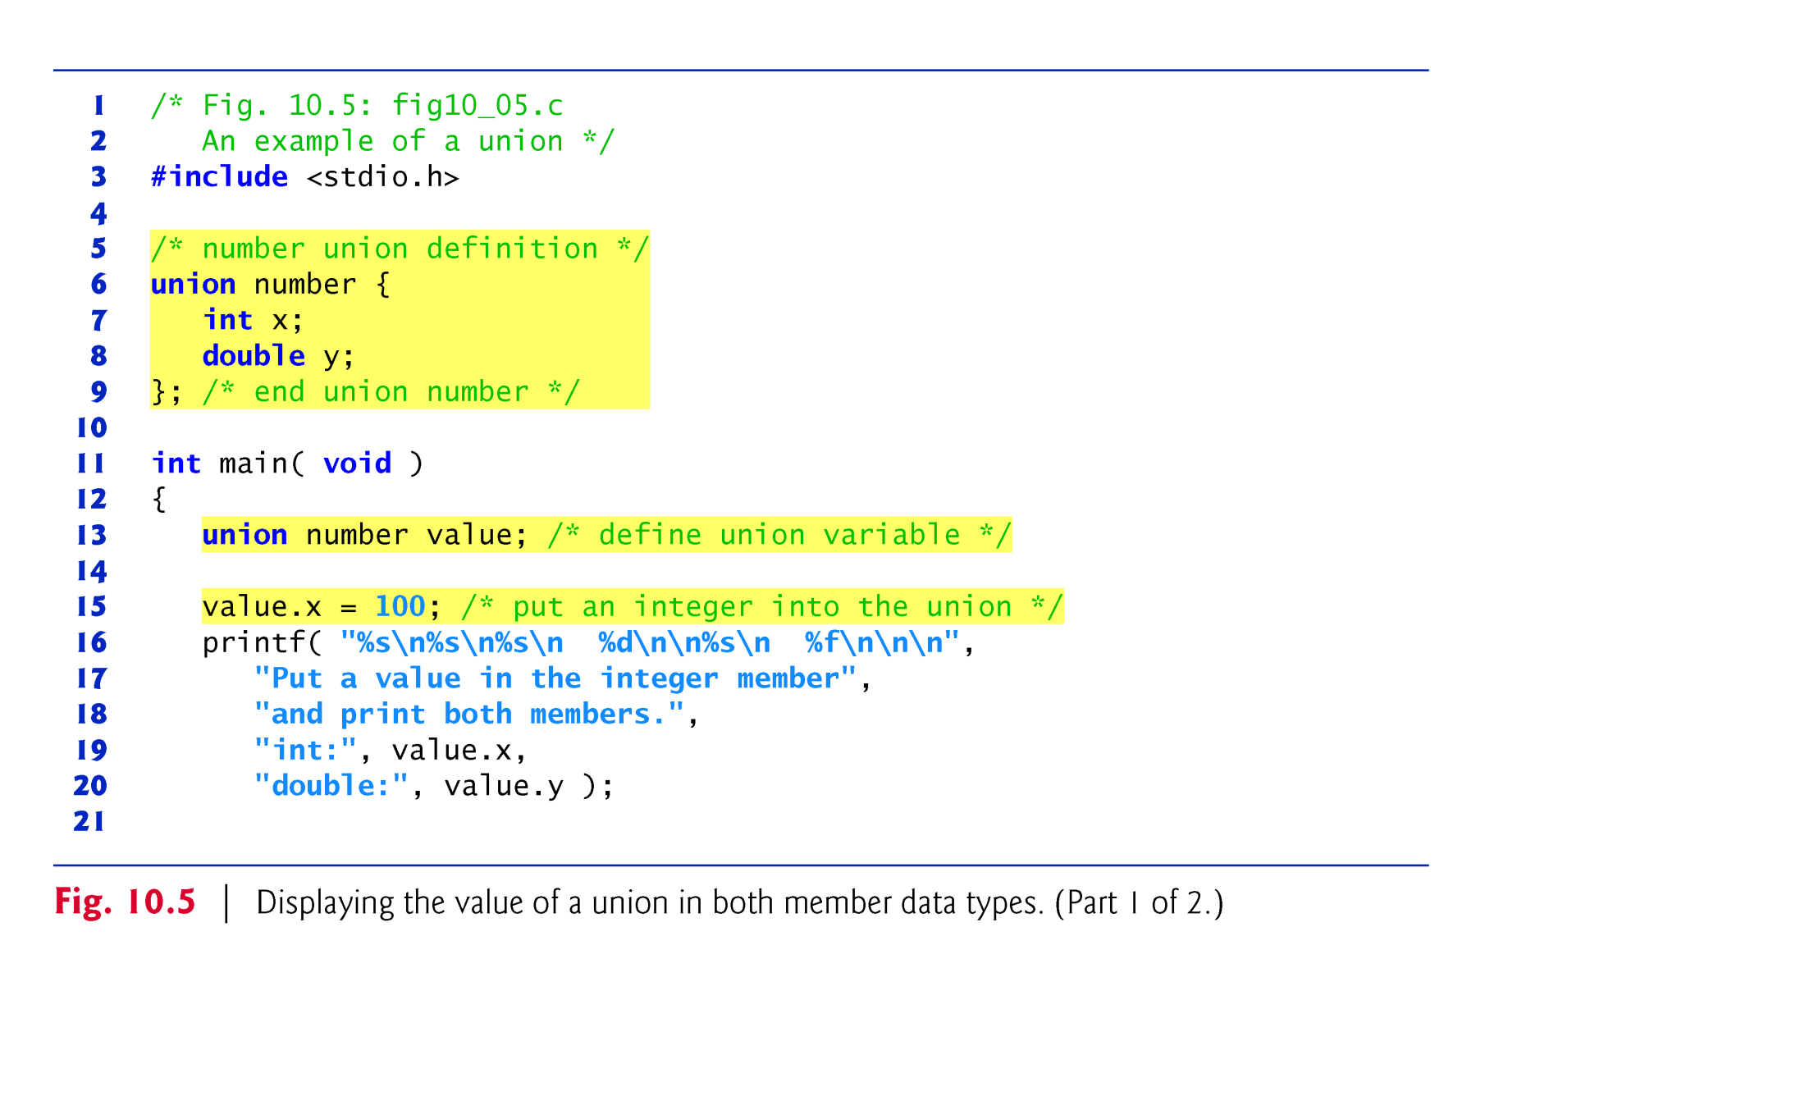
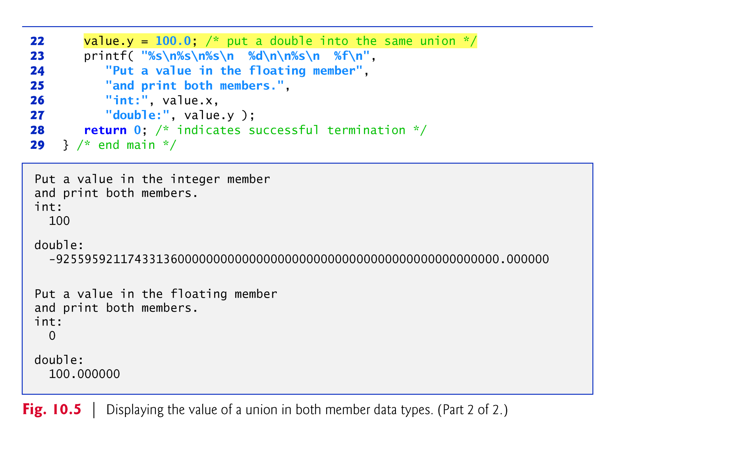
Union Program
Program Name: B. Tech. AI & DS

Slide 10
Union
The program in previous slide uses the variable value (line 13) of type union number to display the value stored in the union as both an int and a double.
The program output is implementation dependent.
The program output shows that the internal representation of a double value can be quite different from the representation of int.
Program Name: B. Tech. AI & DS

Slide 11
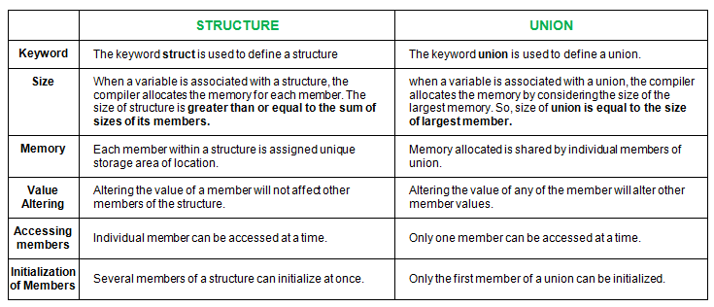
Difference between Structure and Union
Program Name: B. Tech. AI & DS

Slide 12
Difference between Structure and Union
/* C Program to find difference between Structure and Union */
#include <stdio.h>
struct Employee
{
int age;
char Name[50];
char Department[20];
float Salary;
};
union Person
{
int ag;
char Nam[50];
char Departent[20];
float Salar;
};
int main()
{
struct Employee emp1;
union Person Person1;
printf(" The Size of Employee Structure = %d\n", sizeof (emp1) );
printf(" The Size of Person Union = %d\n", sizeof (Person1));
return 0;
}
Output:
The Size of Employee Structure =78 (Padding 80)
The Size of Person Union = 50 (Pading 52)
Program Name: B. Tech. AI & DS

Slide 13
typedef
The keyword typedef provides a mechanism for creating synonyms (or aliases) for previously defined data types.
Names for structure types are often defined with typedef to create shorter type names.
For example, the statement
typedef struct card Card;
defines the new type name Card as a synonym for type struct card.
C programmers often use typedef to define a structure type, so a structure tag is not required.
Program Name: B. Tech. AI & DS

Slide 14
typedef
For example, the following definition
typedef struct { char *face; char *suit; } Card;
creates the structure type Card without the need for a separate typedef statement.
Card can now be used to declare variables of type struct card.
The declaration
Card deck[ 52 ];
Declares an array of 52 Card structures (i.e., variables of type struct card).
Creating a new name with typedef does not create a new type; typedef simply creates a new type name, which may be used as an alias for an existing type name.
Program Name: B. Tech. AI & DS

Slide 15
Enumeration Constants
C provides one final user-defined type called an enumeration.
An enumeration, introduced by the keyword enum, is a set of integer enumeration constants represented by identifiers.
Values in an enum start with 0, unless specified otherwise, and are incremented by 1.
For example, the enumeration
enum months { JAN, FEB, MAR, APR, MAY, JUN, JUL, AUG, SEP, OCT, NOV, DEC };
creates a new type, enum months, in which the identifiers are set to the integers 0 to 11, respectively.
Program Name: B. Tech. AI & DS

Slide 16
Enumeration Constants
To number the months 1 to 12, use the following enumeration:
enum months { JAN = 1, FEB, MAR, APR, MAY, JUN, JUL, AUG, SEP, OCT, NOV, DEC };
Since the first value in the preceding enumeration is explicitly set to 1, the remaining values are incremented from 1, resulting in the values 1 through 12.
The identifiers in an enumeration must be unique.
The value of each enumeration constant of an enumeration can be set explicitly in the definition by assigning a value to the identifier.
Program Name: B. Tech. AI & DS
16

Slide 17
Enumeration Constants
Multiple members of an enumeration can have the same constant value.
In the program (Next slide), the enumeration variable month is used in a for statement to print the months of the year from the array monthName.
We’ve made monthName[0] the empty string "".
Some programmers might prefer to set monthName[0] to a value such as ***ERROR*** to indicate that a logic error occurred.
Program Name: B. Tech. AI & DS

Slide 18
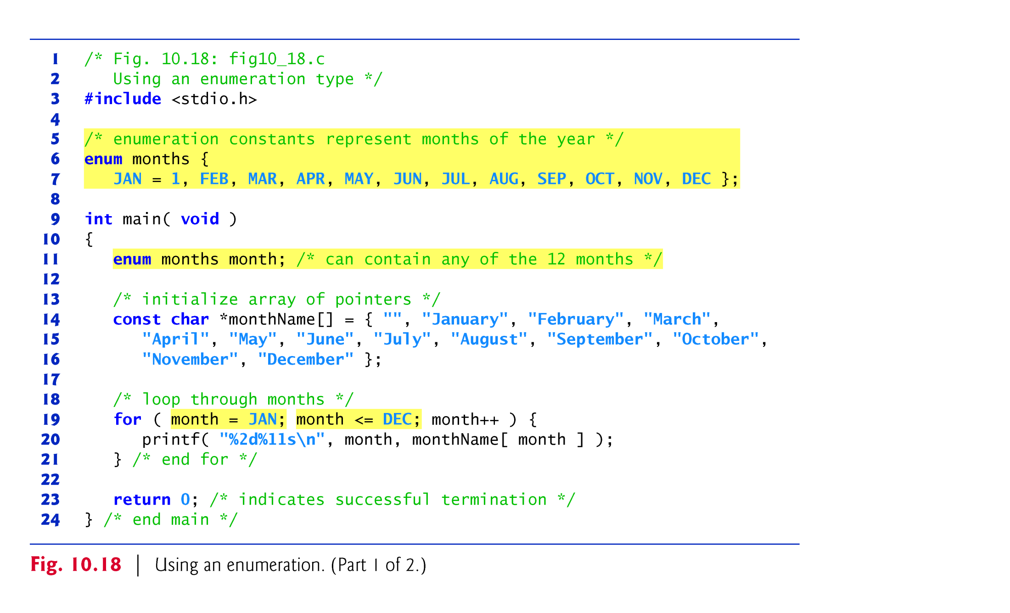
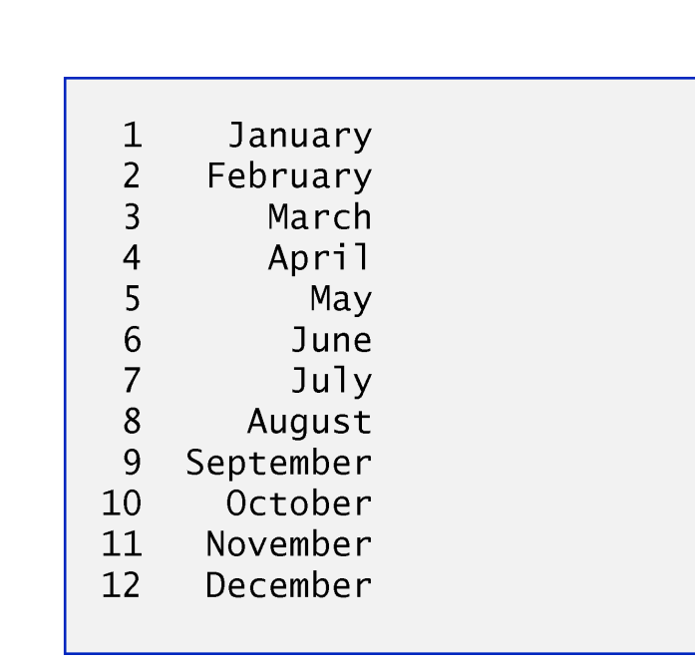
Memory Allocation Functions
Program Name: B. Tech. AI & DS

Slide 19
References
Reference:
‘C’ The Complete Reference - Herbert Schildt
Programming ANSI C, McGraw-Hill – E.Balagurusamy
The C programming language - Brian Kernighan and Dennis Ritchie
Web Reference –
www.geeksforgeeks.org
http://www.d.umn.edu
http://web2.uwindsor.ca
Program Name: B. Tech. AI & DS

Slide 20
Contact Information
Email-ID
sansar.chauhan@galgotiasuniversity.edu.in
Program Name: B. Tech. AI & DS

Slide 21

Prerequisite
Can we allocate only arrays?
malloc can be used to allocate memory for single variables also
p = (int *) malloc (sizeof(int));
Allocates space for a single int, which can be accessed as *p
Single variable allocations are just special case of array allocations
Array with only one element
Program Name: B. Tech. AI & DS

